Slide 1
Archives Portal Europe:
Towards the Google of Archives
IAKH – University of Oslo, 16 May 2023

Slide 2
WHAT IS ARCHIVES PORTAL EUROPE

Slide 3
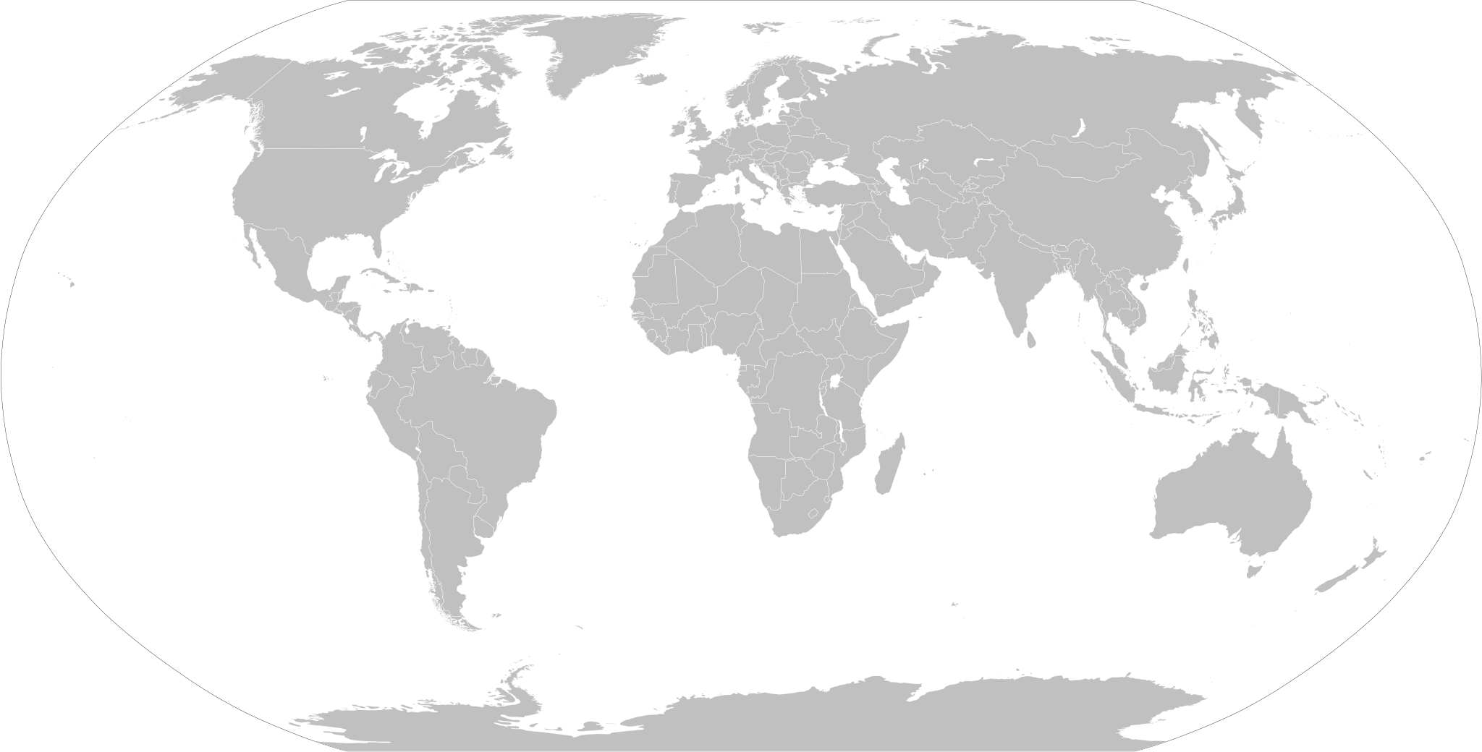
www.archivesportaleurope.net
36
Countries
Institutions
7,100+
Overseas territories
1,100+ active Content Providers
Languages
Types of institutions
Collections
24+
660k+
All EU + Georgian, Hebrew, Icelandic, Turkish
National archives
City & Regional
Private & corporate
Museum
Parishes
Universities
etc….
The largest online
archival portal in the world
Alphabets
5
ქართველი, Ελληνικά, български, עִברִית

Slide 4
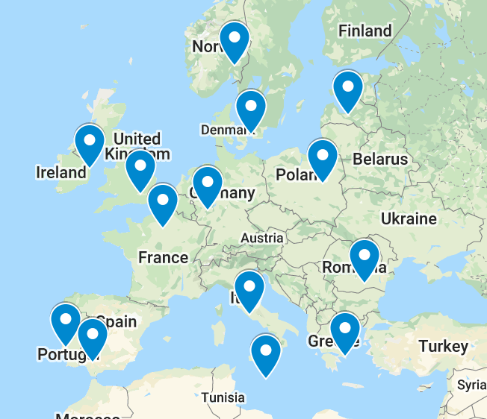
Notes:
A bit of history: with eu integration and particularly wth enlargement to east in 2005, need to access archives around
Problem faced by Germany ìin 1990 with reunification, country at the forefront of digital archives
Not just history: Belgium using a 17thc. Bill for fishing rights on Brexit!!!

Slide 5
Background to Archives Portal Europe
2005 Council Recommendation on priority actions to increase cooperation in the field of archives in Europe
The Internet has helped to position archives as irreplaceable professional providers of information about the past and the roots of the common identity of communities

Slide 6
EU Online Historical Archives - 2005
COUNTRY | SINGLE INSTITUTION | NATIONAL AGGREGATORS | EXTRA EU INTERNATIONAL AGGREGATORS | TOTAL | STILL ONLINE
Czech Republic | - | 1 | - | 1 | 0
Estonia | - | 1 | - | 1 | 0
Finland | - | 2 | - | 2 | 1
France | - | 3 | 2 | 5 | 2
Germany | 2 | 3 | - | 5 | 1
Italy | 3 | 2 | - | 5 | 3
Lithuania | - | 1 | - | 1 | 1
The Netherlands | 1 | 3 | 1 | 5 | 4
Poland | - | 9 | 1 | 10 | 1
Portugal | 2 | - | - | 2 | 1
Slovenia | - | 1 | - | 1 | 0
Spain | - | 3 | 2 | 5 | 1
Sweden | - | 1 | - | 1 | 1
UK | 1 | 4 | 0 | 5 | 3
TOTAL | 9 | 34 | 6 | 49 | 19
EU-level |  |  |  | 7 | 2
Notes:
First a bit of history – since the late 90s many institution-level or national-level projects for archives to use the new technology of the web.
By 2005, many countries in Europe had set up national-level projects to create national databases of finding aids available on the web, and to gather into one web space the different instances created by single archives; the a report from the European Union listed 49 projects in 13 countries, as well as 7 supranational initiatives for interoperability – there was a lot of attention, to look for cooperation on the lines of linguistic and historical affinity: France, Spain and the Netherlands with former colonies, but also Poland about Polish communities in the world.
Most of these projects were about information on the archive, some times the ctalogues, very rarely the actual digitised documents, and only very special collections
Mostly places to provide information
Less than a third of these projects survived to these days (I have a list if you want to see); however, these were the pilot projects from which national level portals, Europeana, and obviously Archives Portal Europe took shape.

Slide 7
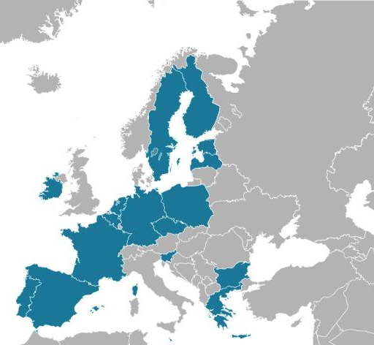
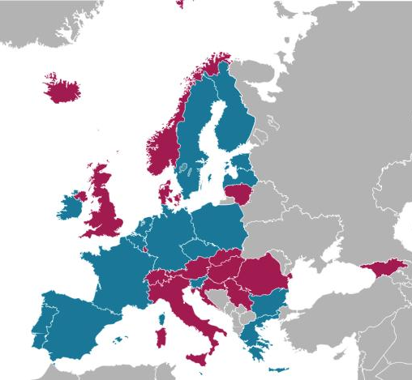
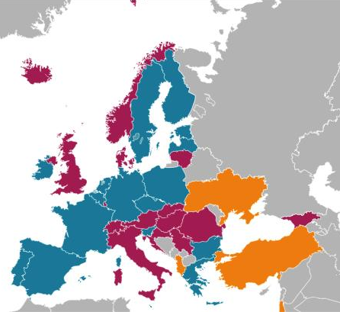
from APEnet ad APEF

Slide 8
1 rep / country
Nat arch/national aggregator
WGs
Structure
Content
Providers
Assembly of Associates
Governing Board
Staff
Content
Providers
any archive
free of charge
Institution Managers
staff
Country Managers
Content
Providers
Content
Providers
Countries that pay a fee to sustain the portal (25)
Appointed by the AoA (6)
NL, ES, HU, CH, BE, RO
Kerstin
Marta
Kostas

Slide 9
Ingestion in the portal
National-level or theme-level
aggregators
Web portal of single institution
No web presence, descriptions organised ad hoc

Slide 10
APE acts as aggregator

Slide 11
Open Source
https://github.com/archivesportaleuropefoundation

Slide 12
Information
Detailed
Type of description
Info on the institution General collections’ info Detailed collections’ info Description of each single collection Description of each single document Link to the doc

Slide 13
Standards
APE - EAD
APE - CPF
APE - METS
Encoded
Archival
Description
Corporate bodies
Persons
Families
Metadata Encoding
and
Transmission Standard

Slide 14
Different technologies
Different admin systems
36 countries
All sort of
archives
VERY multilingual
Different traditions

Slide 15
Technical problems
Usage of a good deal of software, some of them proprietary, which don’t export in XLM
Different hierarchical structures
Machine-readable metadata (ex, date in title)
Special characters

Slide 16
New Research Opportunities
Transnational aspects of European history
Comparative micro-history
Same events as narrated in different cultures
Diverse archival narratives
Same events as narrated by different archives, diverse archival production in comparison
National archives levelled to community/local archives
Quantitative Research
How many documents created by an event/person/etc.
The geography of archival heritage
Simultaneous access to archives
of different level / type
from different countries
in different languages

Slide 17
Examples of projects involved with
Automated topic detection tool
DE-BIAS project
EU-funded project (PI. Deutsches Filminstitut & Filmmuseum)
Develop a tool that automatically detects offensive terms in cultural heritage metadata and provides information on their problematic background, using vocabularies focused on three main topics: migration and colonial past; gender and sexual identity; ethnicity and ethnoreligious identity.
Anti-colonial archive working group
Metadata Digitisation grants
Research grants (academic and creative)

Slide 18
Sharing Access to European Memory
Improve capacity (more and better data)
Easier (and more) access
A portal for EVERYONE
Develop tools for easier research
Help researchers
Cancel barriers (language, geography, costs)
A social machine
Put researchers and archivists in contact
A glocal network of users and archivists
Services for archives
Networking and help archival institutions
Develop common best practices

Slide 19
Core Objective
Gathering and give access to the
COLLECTIVE MEMORY
of the EUROPEAN CITIZEN

Slide 20
HOW IT WORKS

Slide 21
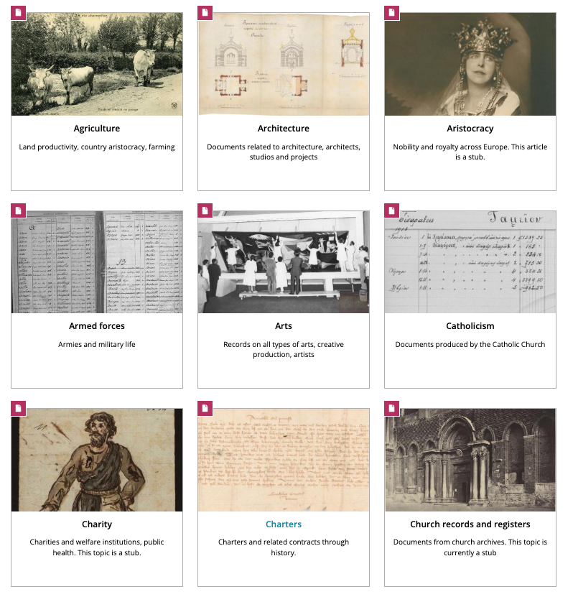
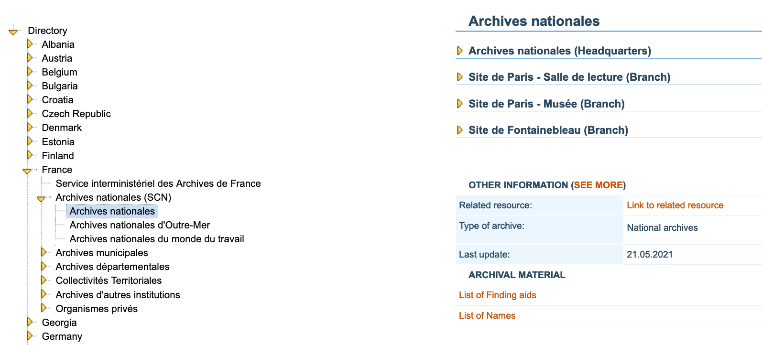
Searching in APE
BY TOPIC
BY INSTITUTION
Notes:
By Institution: the classic way, you start with an institution and you search the catalogue. By Topic: organised collections from different archives in different countries, organised around a topic

Slide 22
Searching in APE
BY KEYWORDS
Notes:
the main way

Slide 23
Multilingual Search - operators
Boolean Operators
And
Or
“ “
Wildcards
? = can be any character
* = any character can follow
Наполеон OR Ναπολέων OR Napoleon OR Napol??n*

Slide 24
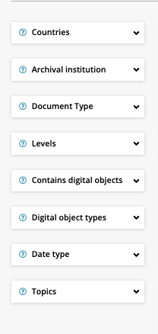
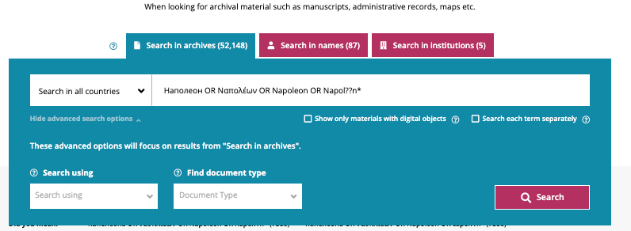
Filters
Notes:
Searches in three places in the repositories: ARCHIVES= catalogue collections; NAMES = descriptions of records creators; INSTITUTIONS = information on the archival institutions themselves
You can select to only use material with digital objects; if searching ALL the word in the search, or just one (equivalent to the AND or OR operators) And various filters: which counties, which institutions, the type of document, the date, the topic…. however plz note, only if these filters are in machine readable format (eg dates, very rarely)

Slide 25
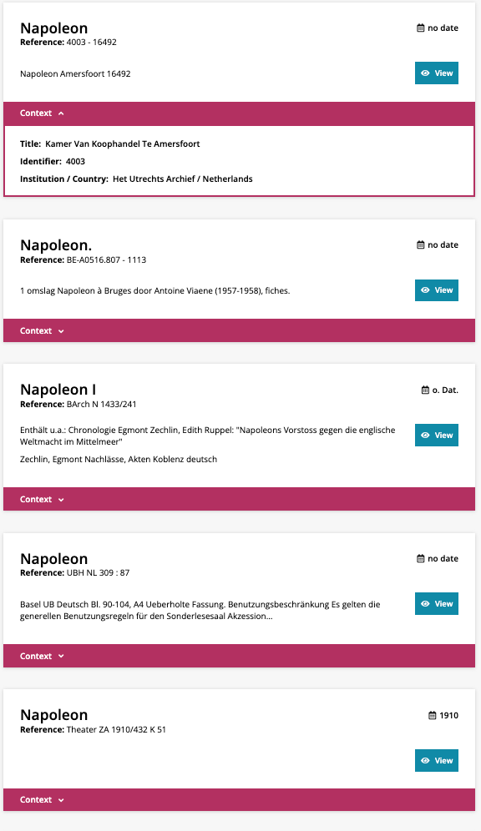
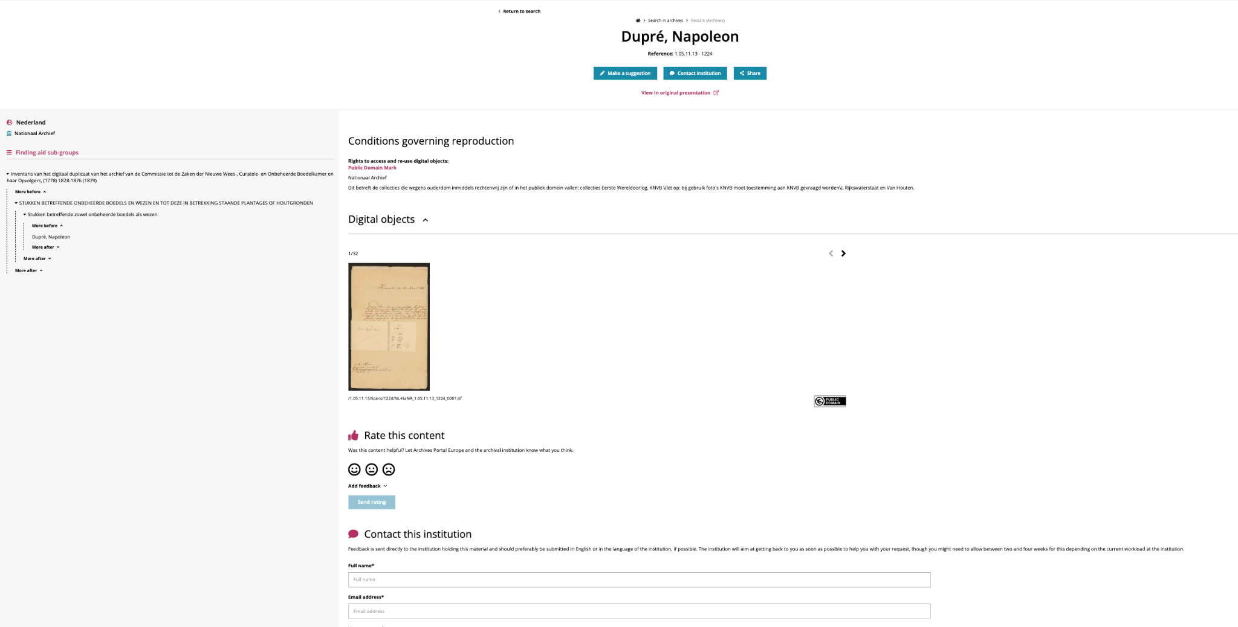
Results

Slide 26
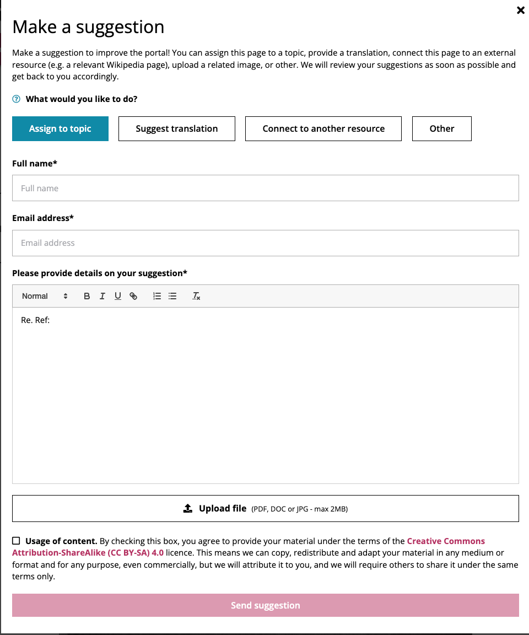
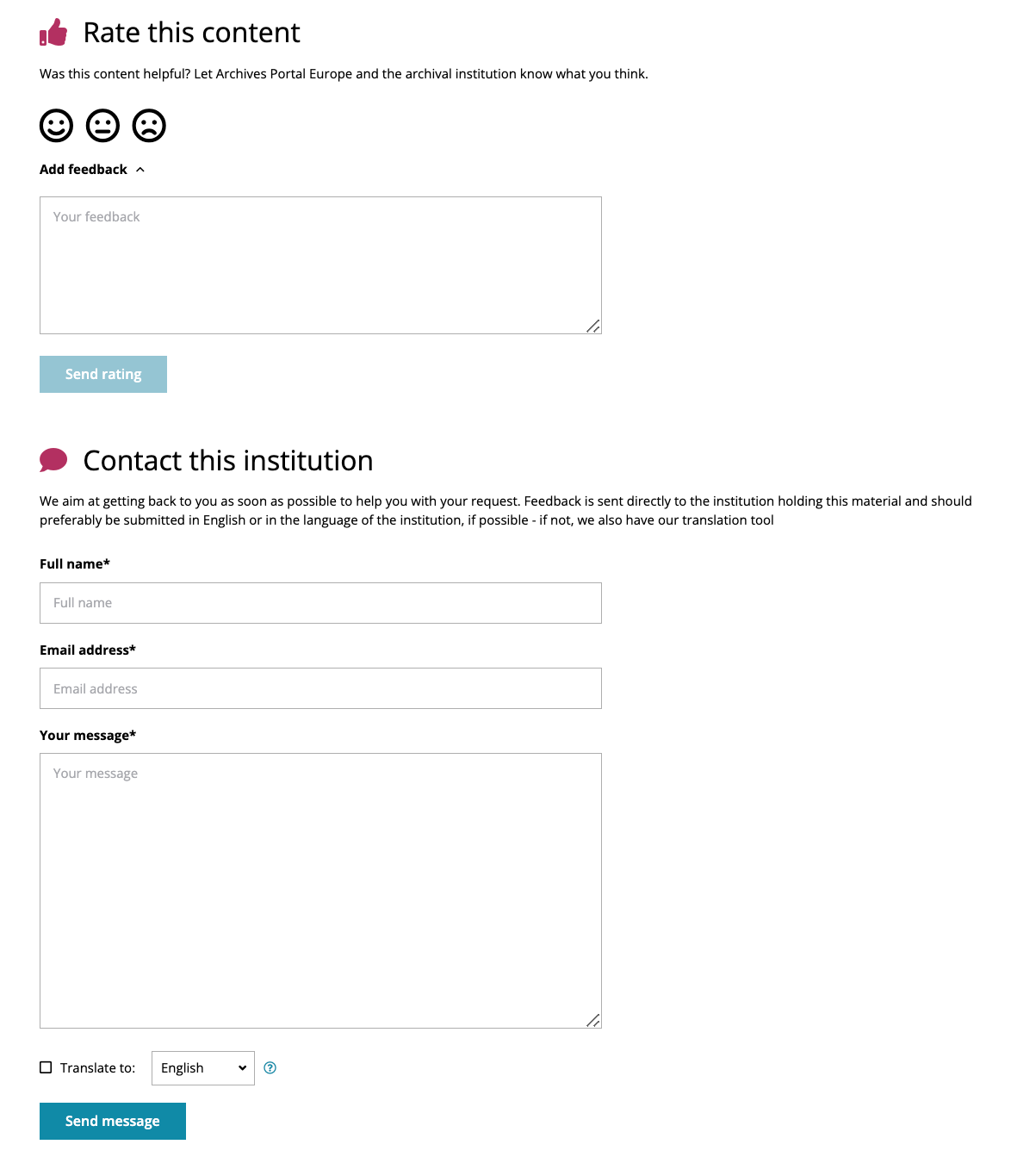
A network of archives
and researchers

Slide 27
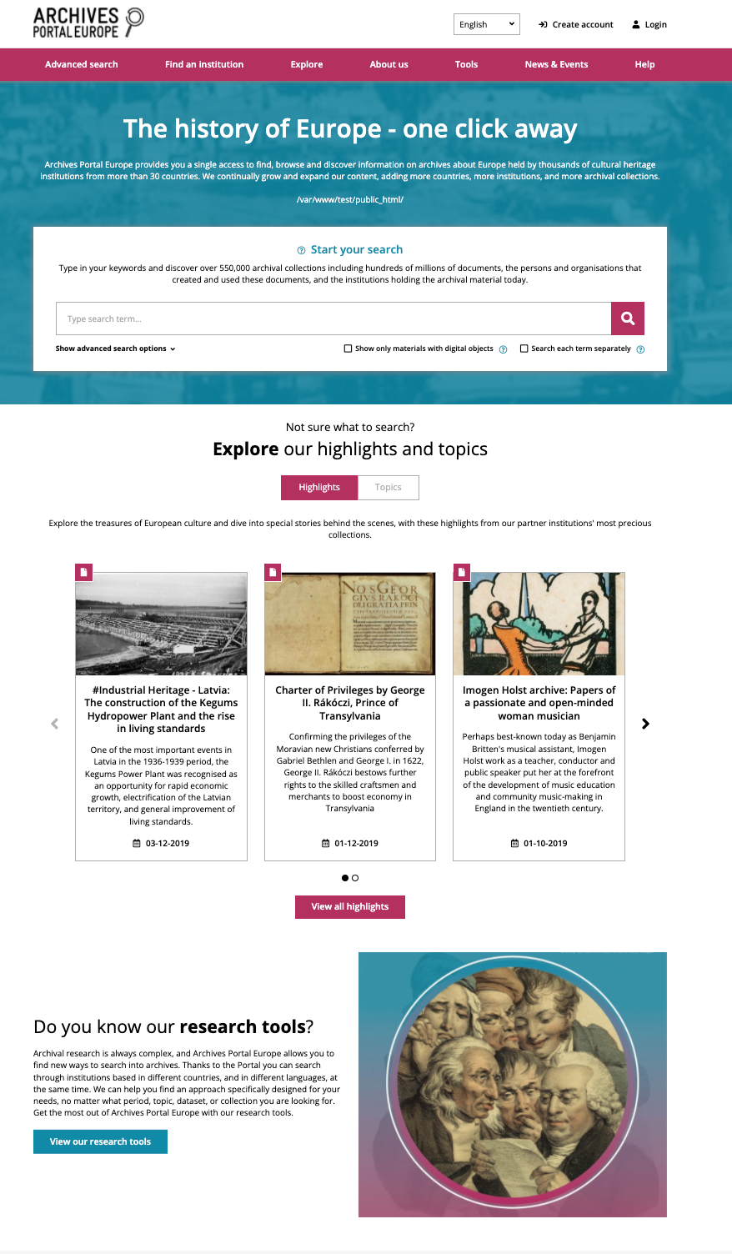

Slide 28
Thank you
for your attention !
www.archivesportaleurope.net
@archivesportal
marta.musso@archivesportaleurope.net
info@archivesportaleurope.net

